Slide 1
AI-Powered SQL Assistant
Runtime Terror

Slide 2
MAJOR PROBLEMS IDENTIFIED
1. The dearth of technical knowledge to understand the concepts of OLAP and successfully optimizing it.
2. The need to adapt towards various SQL dialects in the same platform for distributed access.
3. The lack of context of personalised database in leading LLM platforms.
4. The increasing issue of fine-tuning AI for every small task that involves domain knowledge.
5. Incorporation of feedback for personalised recommendations.
6. A common platform for distributed access with an execution engine.

Slide 3
OUR PROPOSED SOLUTIONS
Creating Optimal Vector RAG Stores for Hybrid Search incorporated with Hybrid Search, Re-ranking and HYDE.
Adhering to Official Documentation, Official Community for Optimization, Performance Considerations and Syntax.
Smart Feedback Mechanism Based on Context of Chat History and User Feedback.
Interactive UI with built-in Execution Engine along with auto-suggestions.
Integrating custom DBs using Docker containers for distributed access.
Request-Response Models for Advanced and Personalized Modules.

Slide 4
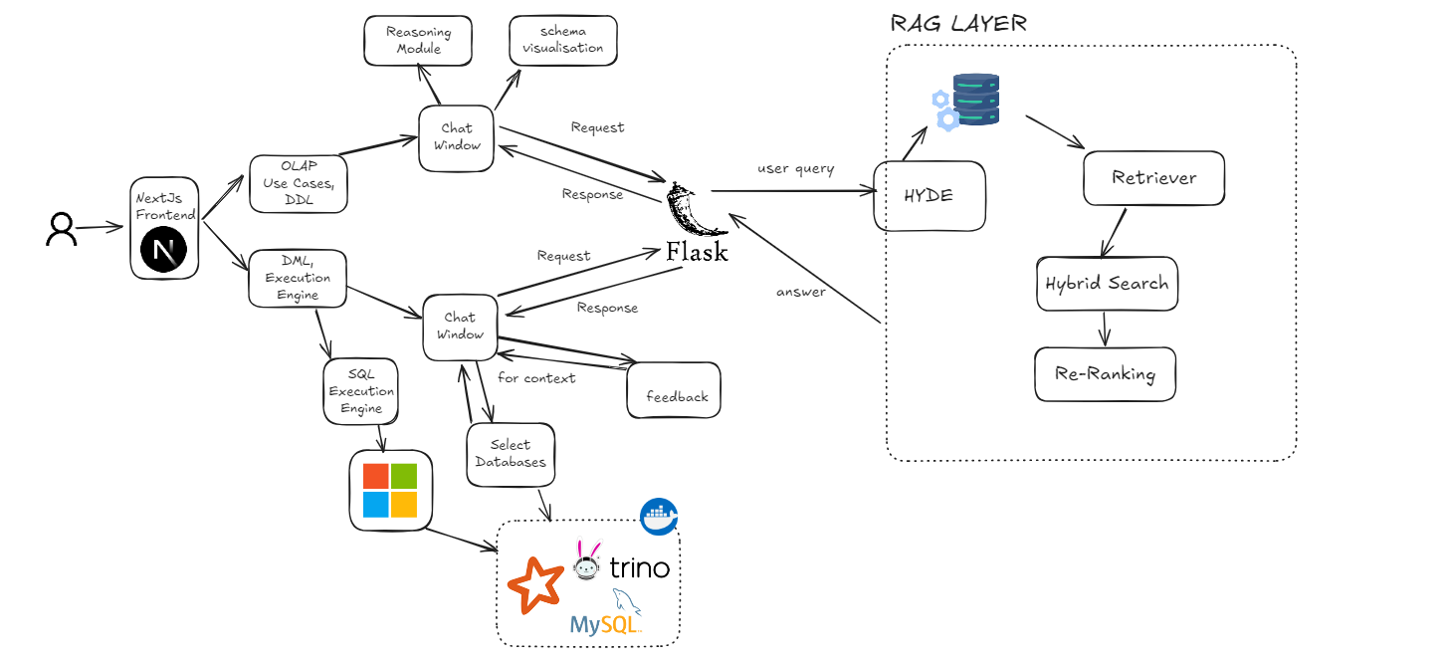
IMPLEMENTATION & TECH STACK

Slide 5
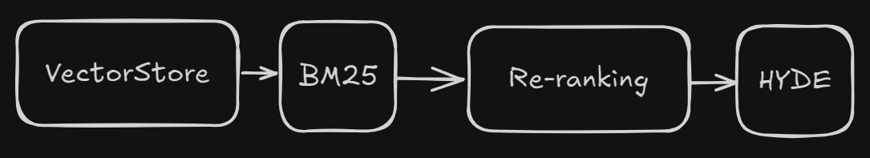
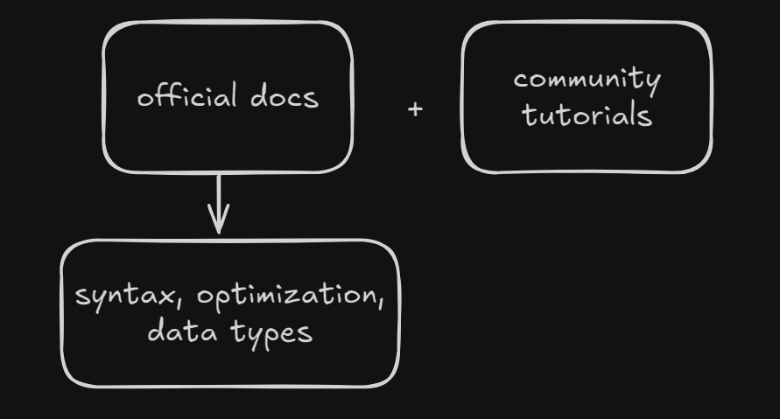
OUR SOLUTIONS
Advanced RAG with Optimal Vector Stores
Code Generation for SQL Dialects,
OLAP Database Schemas, Best Practices, Optimization suggestions
Official Documentation and Community Examples for syntax, performance and best practices,

Slide 6

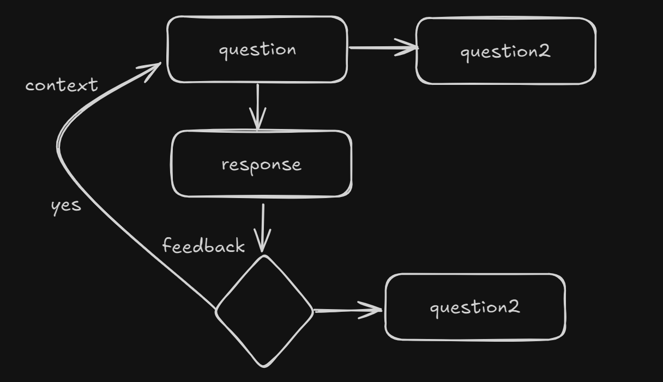
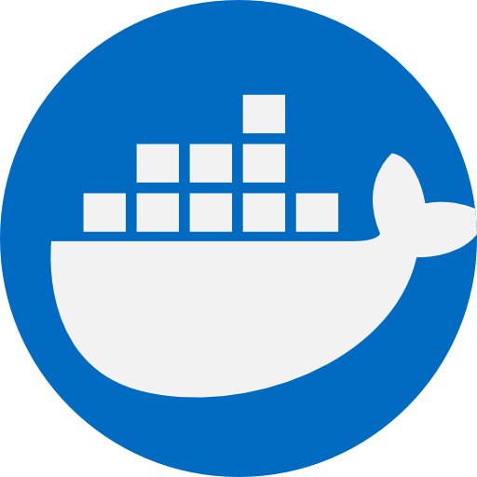

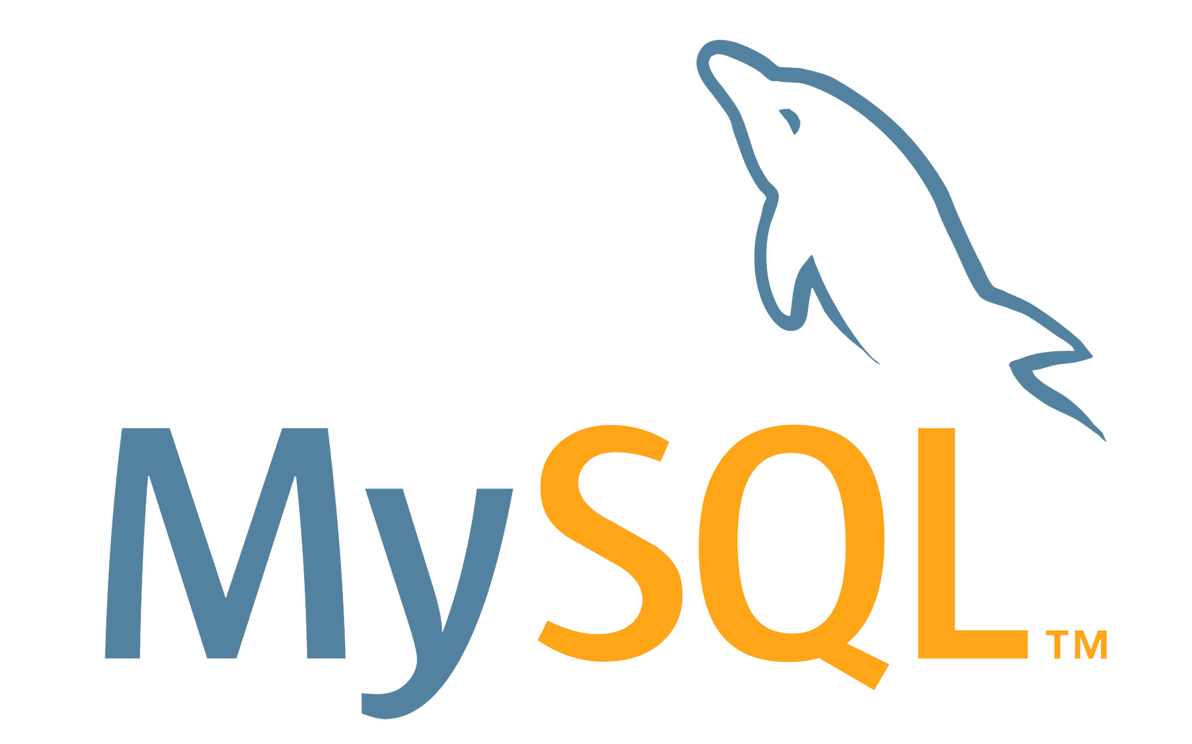
OUR SOLUTIONS
Execution Engines
Integrating custom DBs using Docker containers for distributed access.
Smart Feeback Mechanism for finetuning the queries according to your needs or for corrections.

Slide 7
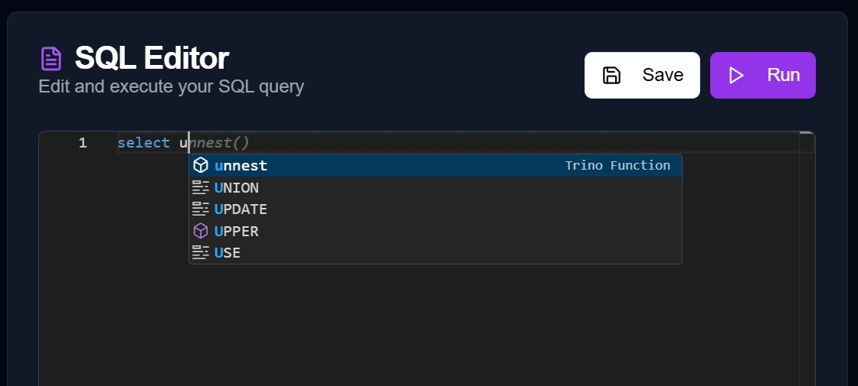
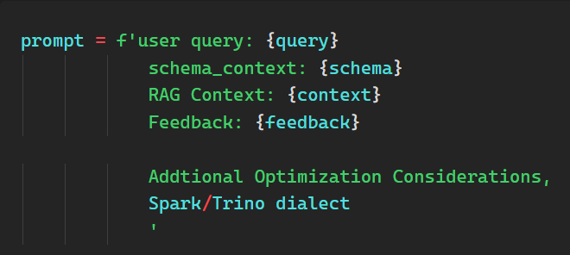
OUR SOLUTION
Monaco based smart editor with suggestions, and facility to run queries and test the results in virtual engine.
Hyper-personalised queries with smart prompt templates for better answer formulation.

Slide 8
Key Phases
Phase 1: Integrating Databases Execution Engines in the Platform. Leveraging Trino and Spark with databases, Passing context for Execution Engines efficiently
Phase 2: Visibility for available databases from local SQL, passing the schema as context for accurate queries and results.

Slide 9
Key Challenges Overcomed
Created Docker Containers for running Spark and Trino, created a Docker Container for MySQL for connecting and querying various databases.
Added the visibility of all available databases using REST APIs, allowed user to choose and pass them as context for accurate Trino/Spark SQL queries (for both query generation and feedback)

Slide 10
OUR UNIQUE VALUE PROPOSITIONS
e.g) star, snowflake
OLAP Schema Suggestions for Optimization with REASONING.
ADVANCEDRAG
High Quality Data Sources for Performance and Syntax Accuracy
REDUCED COSTS
Containerized
Distributed Access
Smart Feedback and context using Circular Queue
Virtual Execution Engines with Database Connectivity
Enhanced Visualisation of Schemas

Slide 11
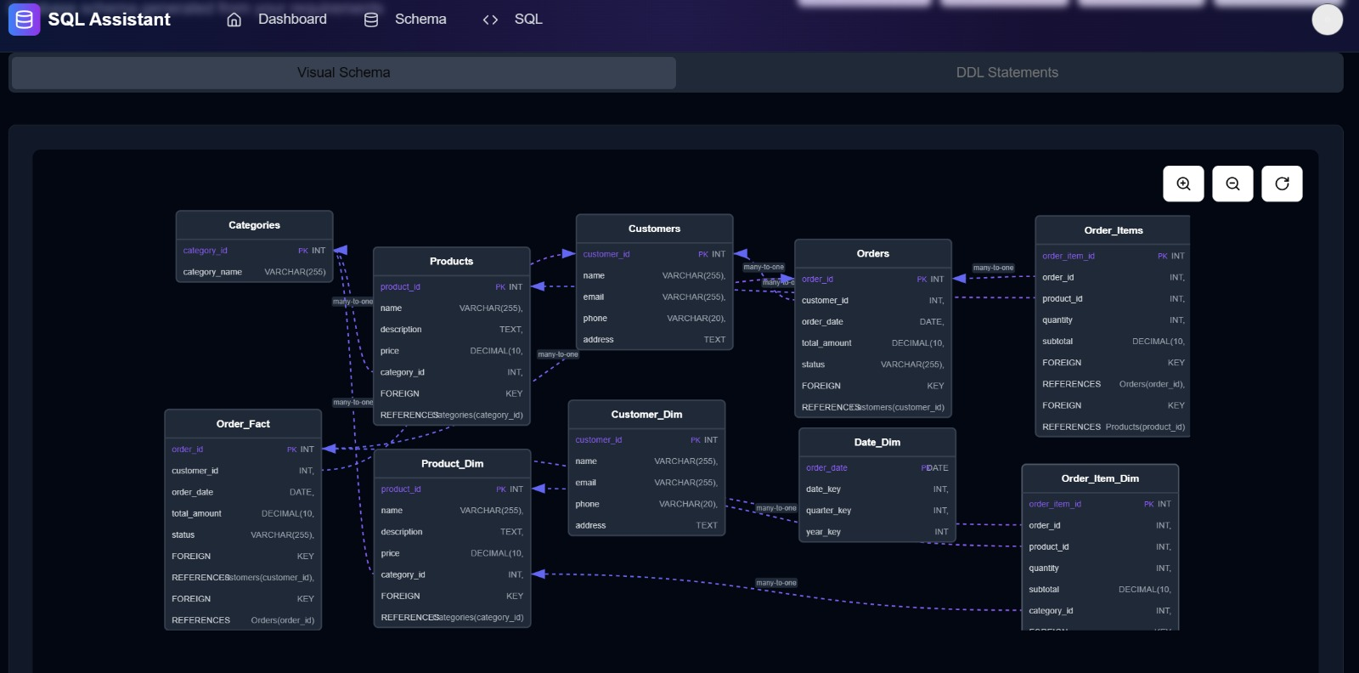

Slide 12
BUSINESS MODEL & SCALABILITY
The business can expand and stay sustainable in various ways. We are aiming pay as you go model
Users can be charged on the basis on number of connectors (databases)
Users will be charged on number of tokens they use
Users will be charged on the basis of cpu/gpu usage for the containers
(All of these monthly based on amount of connectors, tokens and computing resources)
We can partner with these database system to further sustain our systems and services
Scalability
Containers can be put into Kubernetes for auto-scaling and monitoring is also being planned
Allowing multiple connectors as much as supported by Trino/Spark
Scaling the AI system by using more optimized version i.e., microservices based
Optimizing the system for handling parallel executions for distributed query processing

Slide 13
THANK YOU!

